Slide 1



Wolters Kluwer: Health - Language model
AI-powered differential diagnosis support for faster, more accurate clinical decision-making
09th May, 2025

Slide 2
01
Team Introduction
02
Business Problem & Core Objective
03
Project Timeline
Agenda Overview
04
Data Overview
05
Solution Walkthrough
06
Project Outcome Metrics
07
Product Prototype & Simulated Conversations
08
Future Recommendation

Slide 3




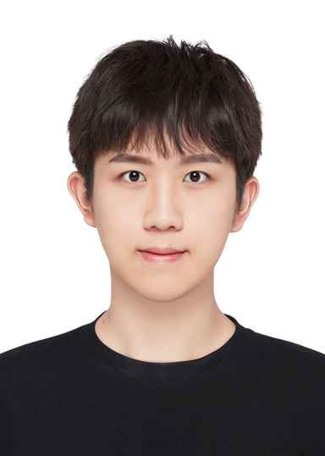
Team members
Nikhita Shankar
Anidya Singh Bhandari
Anish
Saha
Shaoyang Sun
Haijun Zeng

Slide 4
Core Objective & Technical Challenge
Business Problem:
Can Large Language Models (LLMs) support clinicians by generating accurate differential diagnoses from patient case data?
WHY IT MATTERS
Reduces diagnostic errors & enhances early detection
Accelerates clinical decisions & improves outcomes
Increases efficiency and lowers costs
SUCCESS CRITERIA
High Top-3 & Top-10 diagnosis accuracy
Consistent performance across note types (brief, detailed, simulated)
TECHNICAL CHALLENGE
Adapting to structured/semi-structured clinical data
Minimizing hallucinations via tuning & prompt design
EVALUATION METRICS
MRR & DCG for diagnosis ranking
Reduction in hallucinated outputs via temp/prompt control

Slide 5
project Timeline
February
March
April
Week 1-2: Scoping & Alignment
Finalized vision with stakeholders
Defined metrics & shortlisted LLMs
Week 3-4: Data Strategy Setup
Curated NEJM case reports
Standardized inputs (JSON) & prompts
Week 1-2: Model Testing
Ran experiments with GPT-4, Claude
Tuned parameters & evaluated rankings
Week 3-4: Prototype Development
Built Streamlit UI for real-time suggestions
Integrated ranked outputs
Week 1-2: Final Delivery
Simulated doctor–patient conversations using NEJM case data
Tested LLM performance on dialog-based inputs
Week 3-4: Tidying Up
Evaluated research-grade models from Perplexity and Gemini
Compiled results and insights into a final internal report

Slide 6

Data Overview
Data Sources
Data Processing
Development Stack
25 NEJM (New England Journal of Medicine) case reports (late 2024–early 2025).
Extracted patient histories into different formats: short, full-length, and simulated dialogues.
Text cleanup, prompt engineering, simulated ambient listening.
OpenAI ChatGPT-4o APIs, Google Gemini 2.5 Pro APIs.
Python (Streamlit for prototype).
Collaborative notebooks for model experimentation.

Slide 7
Solution Walkthrough
Prompt Structures
Model Evaluation
Prototype Development
“Atom of thought” prompting: include context, goal, warnings, expected output.
JSON-formatted inputs: structured patient history and clinical context fed to the models.
Ranking diagnosis outputs based on Top-3 and Top-10 correctness.
Metrics used: Mean Reciprocal Rank (MRR), Discounted Cumulative Gain (DCG).
Built a Streamlit app enabling:
Patient history input
Ranked diagnoses output
Reasoning and next steps
Red flag alerts
Report export functionality (PDF).

Slide 8
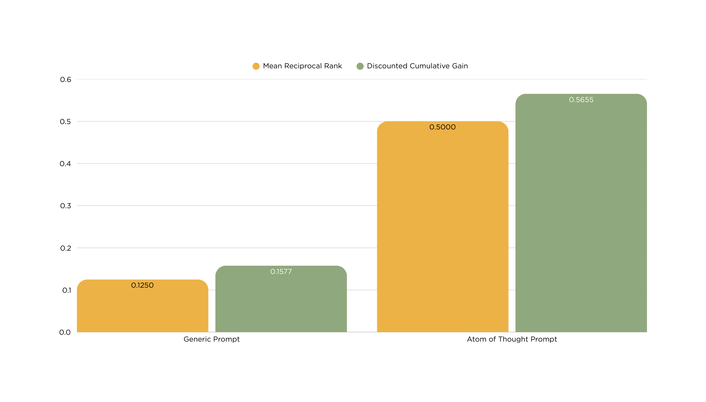
diagnosis prompt comparison
Higher is better

Slide 9
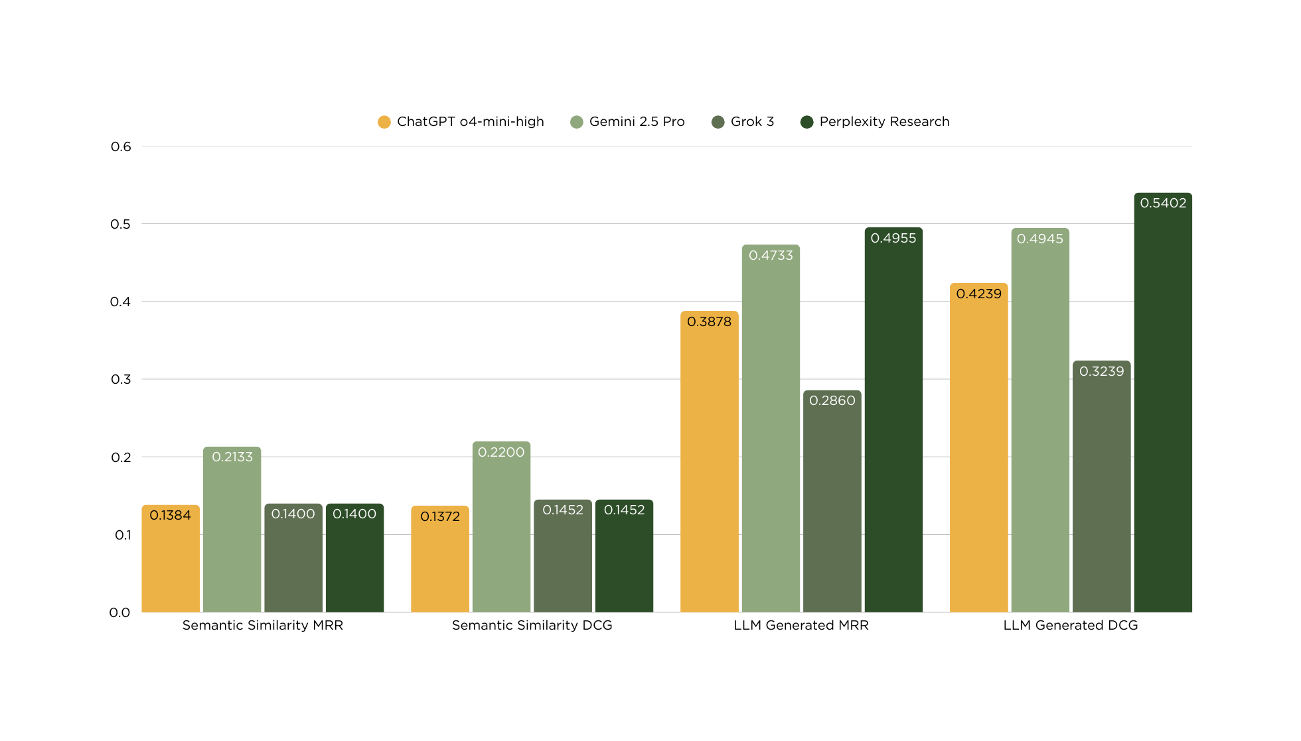
diagnosis evaluation comparison
Higher is better

Slide 10

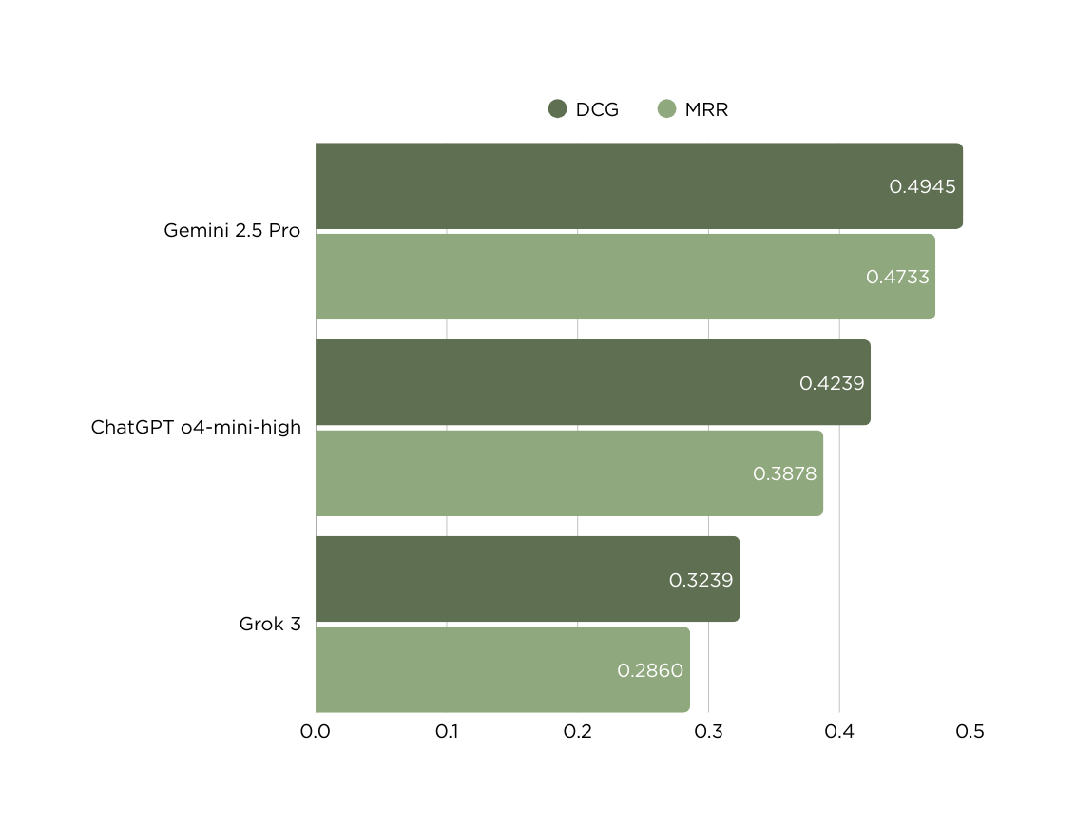
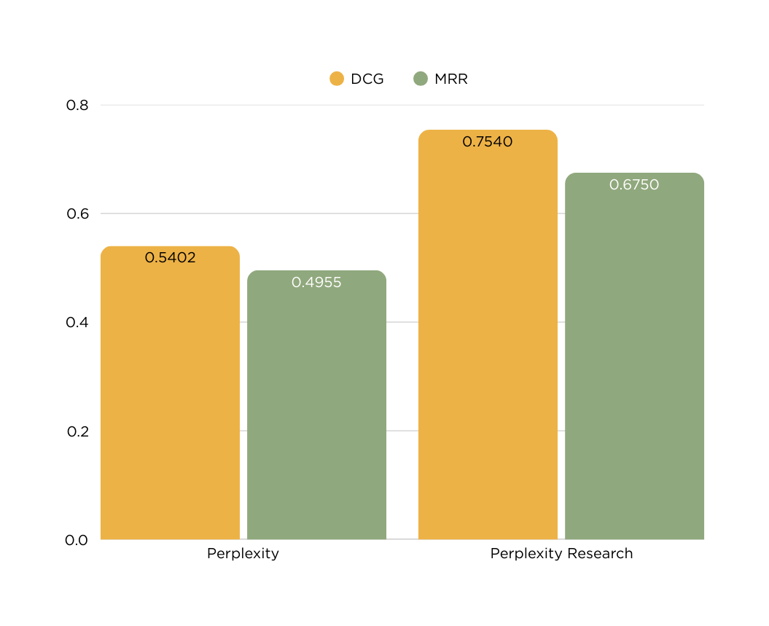
MODEL PERFORMANCE
Google vs OpenAI vs xAI
Perplexity
Higher is better

Slide 11
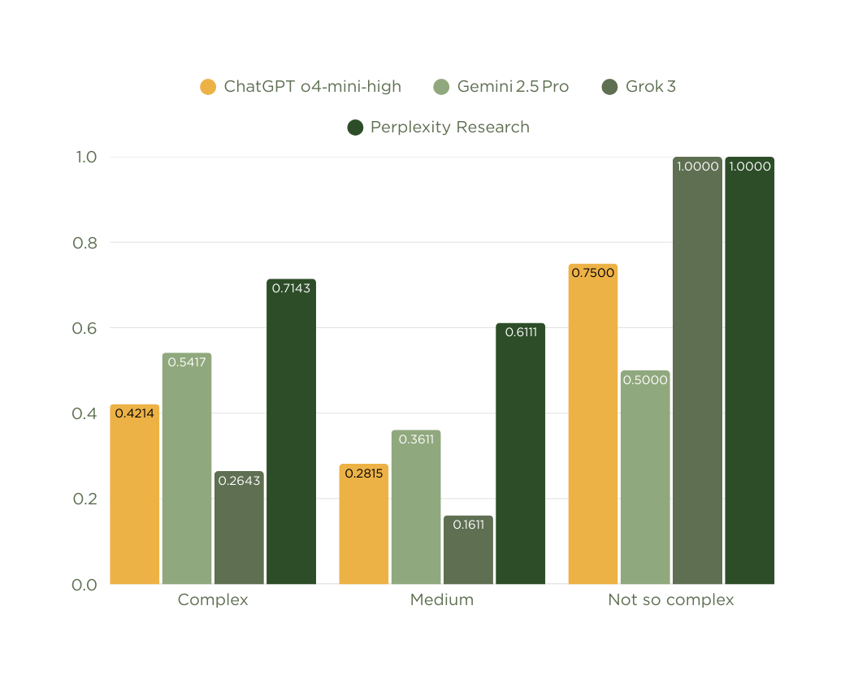
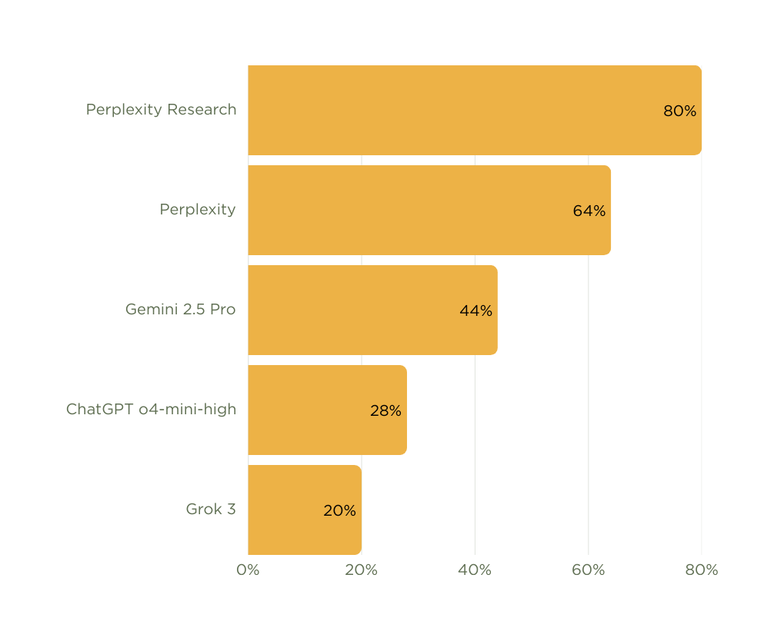
MODEL PERFORMANCE
MRR based on case complexity
Top-3 Accuracy Percentage
Higher is better

Slide 12
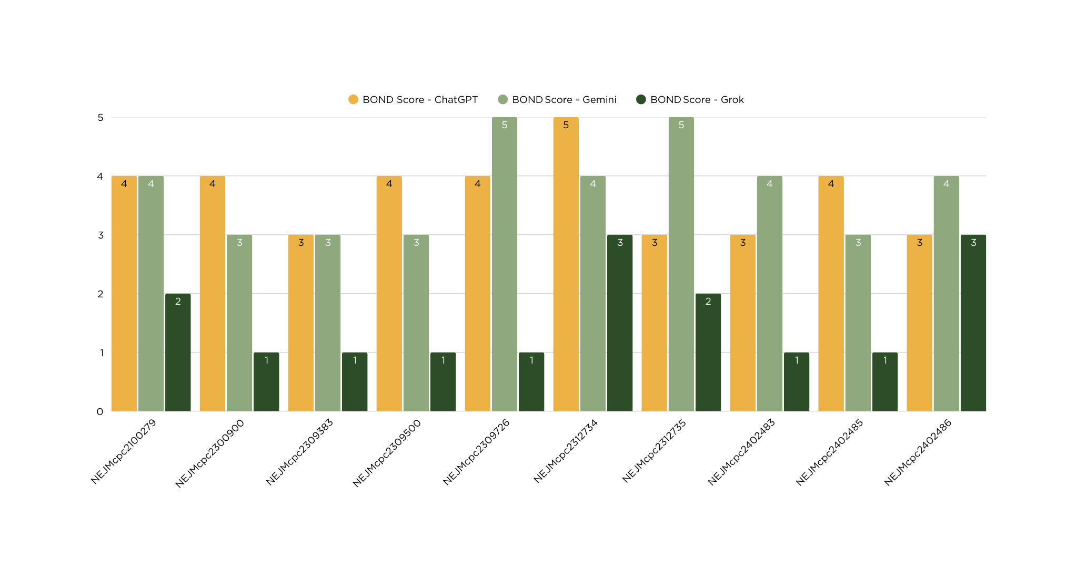
evaluation of next steps
BOND Scores: 1 - No relevant overlap. 2 - A vague relation. 3 - Closely related. 4 - Very close to the gold standard. 5 - An exact match.

Slide 13
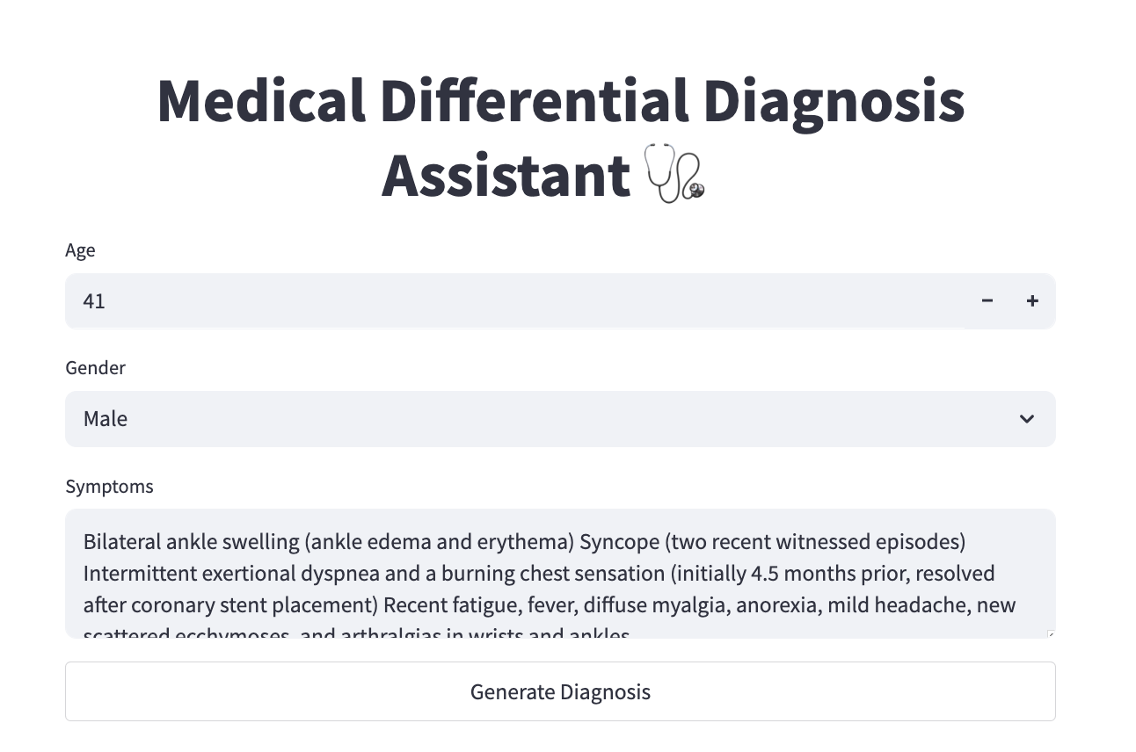
product prototype

Slide 14
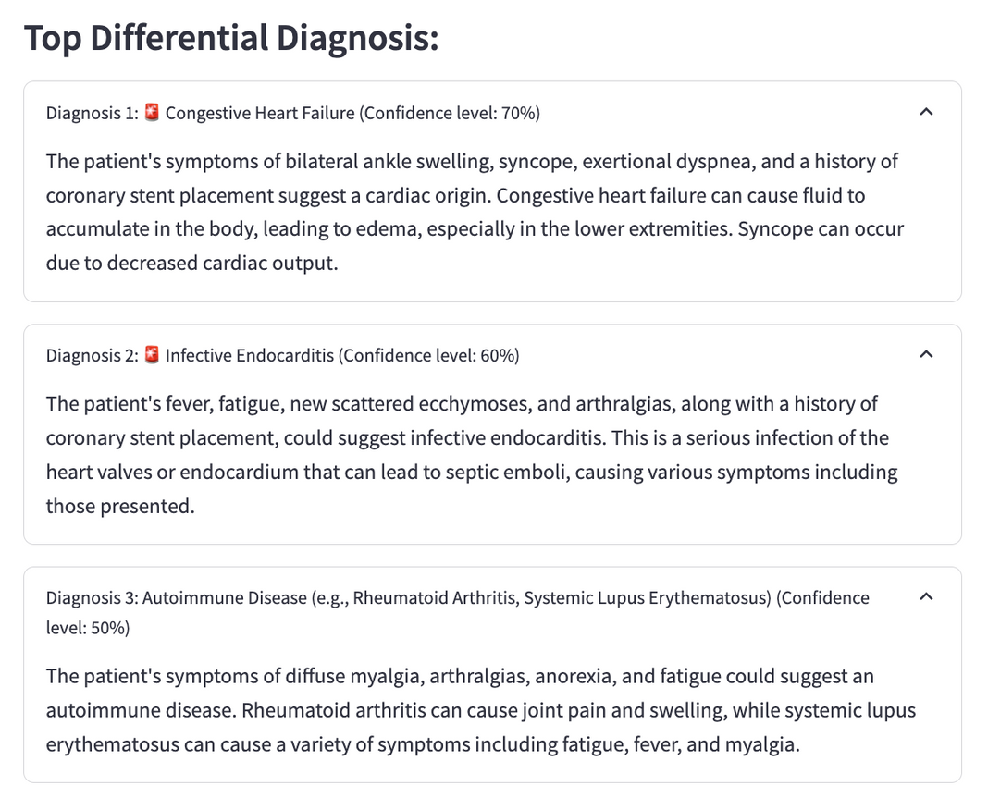
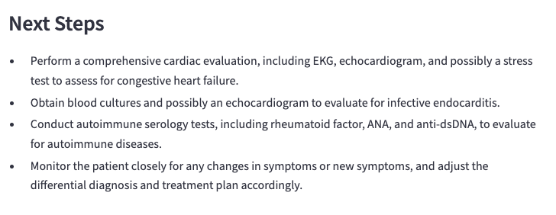

Slide 15
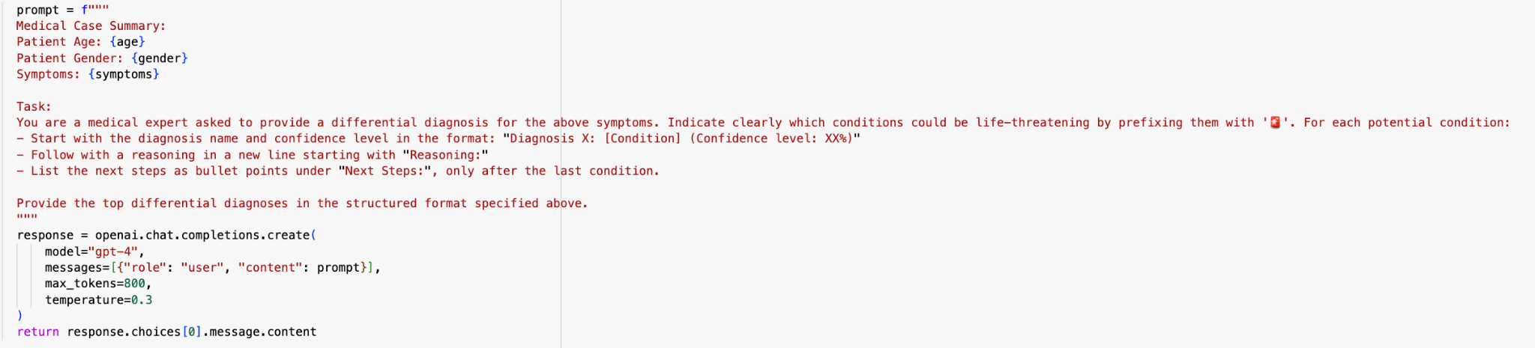
Backend prompt structure
Structured prompt includes age, gender, and symptoms
Clearly defined task and output format for consistent responses
Uses "Diagnosis + Confidence + Reasoning + Next Steps" structure
Prompts model to flag life-threatening conditions with 🚨
Outputs are generated using GPT-4 API with temperature set to 0.3 to reduce hallucinations

Slide 16
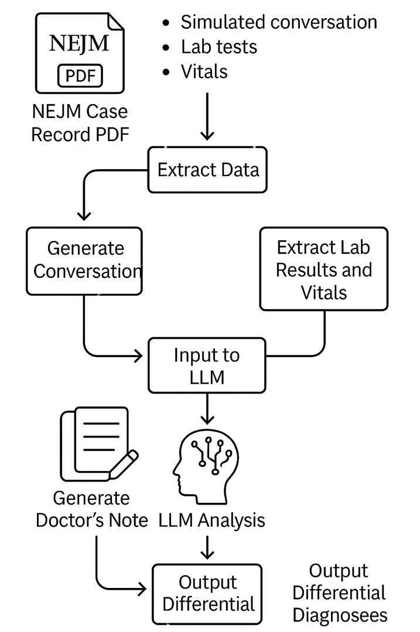
SIMULATED CONVERSATION WORKFLOW
In the absence of real doctor–patient conversations, we simulated dialogues using NEJM case records and LLMs.
Extracted lab results, vitals, and history from PDFs to build structured inputs.
Generated simulated conversations and doctor-style notes.
Fed inputs into LLMs to produce:
Ranked differential diagnoses
Red flag alerts for critical conditions
Enabled testing of diagnostic reasoning in a realistic, reproducible setting.

Slide 17
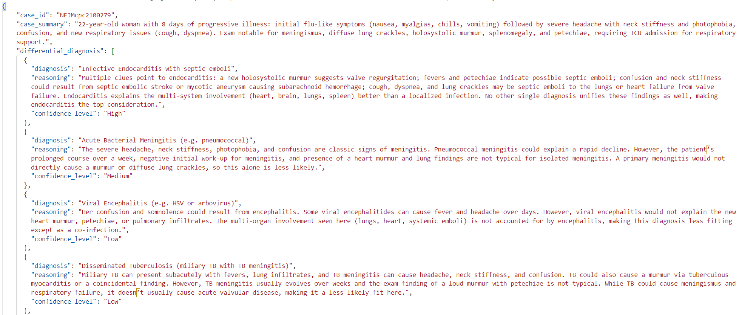
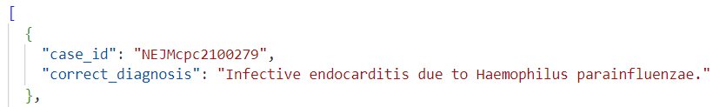
Generated vs Actual output

Slide 18
Future Recommendations
KEY FUNCTIONAL GOALS
FUTURE ENHANCEMENTS
Use real doctor–patient audio for natural context
Dynamically update diagnoses during conversations
Highlight red flags instantly
Auto-generate concise clinical notes
Serve as a voice-aware diagnostic assistant
Ensure end-to-end data privacy & security
Add RAG from trusted medical sources
Incorporate real or simulated clinical audio
LONG-TERM VISION
Develop multi-agent systems for internal validation
Enable live clinical dashboards for real-time support

Slide 19
Thank You
09th May, 2025

